Slide 1
Modelling for LASER Cladding Process
Mrunmayi Mungekar
Darshil Desai
Manoj Parmar
Tanya Gupta

Slide 2
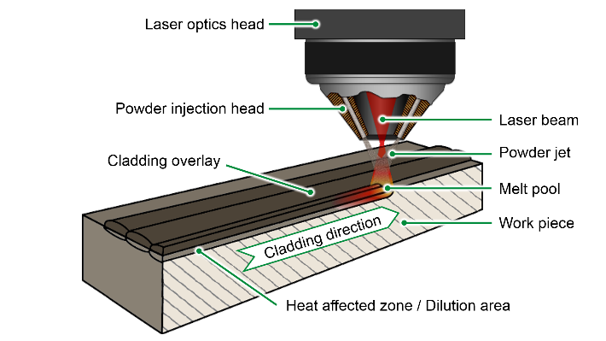
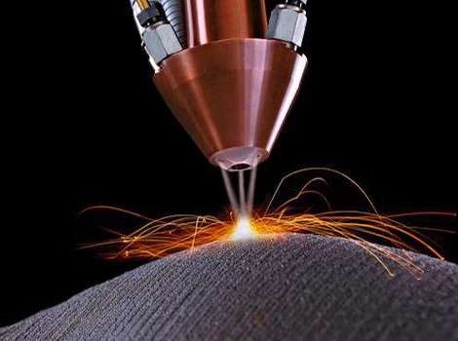
MODELING OF LASER CLADDING
Powder distribution, Melting, Ricochet
Laser, Optics,
Intensity Distribution
Melt Pool Dynamics
Buoyancy, Surface tension,
Marangoni effect
Solidification,
Stefan Problem,
Three Phase
Deposition geometry
Mellurgical effects
Residual Stress
Preliminary Objectives
Develop a model to predict the temperature and stress distribution of the Laser cladding process
Code various phenomenological equations to estimate some secondary variables:
Hardness
Phase Transformations and its effects
Grain size
Facilities are available in the machine tool laboratory if you want to conduct some preliminary experiments to validate your computational model

Slide 3
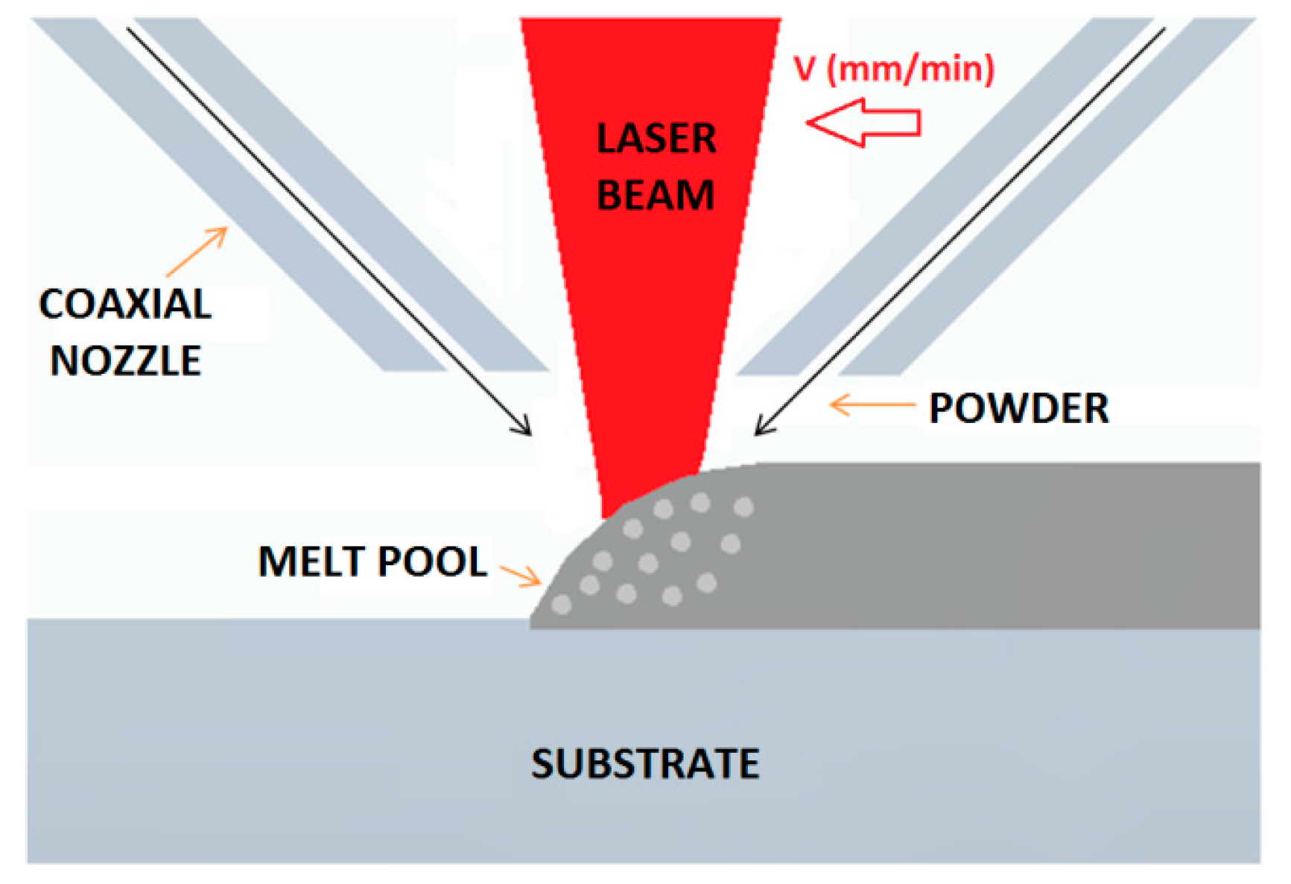
Laser cladding process
Laser cladding is a coating technique, wherein several layers of clad materials are deposited over a substrate so as to enhance the physical properties of the work-piece such as wear resistance, corrosion resistance, etc.
Strong interfacial bond with minimum dilution between the material layers is a pre-requisite of the process. This technique also finds widespread applications in repair and restoration of aerospace, naval, automobile components

Slide 4
Temperature distribution
Because of higher power, rapid heating and cooling rate, small size molten pool, high temperature in laser cladding, it is very difficult to measure its internal temperature distribution and the cooling speed. At present, material temperature field distribution under the action of laser is obtained by means of numerical analysis and numerical simulation

Slide 5
Numerical simulation assumptions
To simplify calculation the follow assumptions is made:
Materials are isotropic
Neglecting the flow function of molten pool fluid
Neglecting material vaporization
Neglecting keyholes effects, latent heat of phase change and thermal deformation

Slide 6
References
http://citeseerx.ist.psu.edu/viewdoc/download?doi=10.1.1.861.3911&rep=rep1&type=pdf
https://www.researchgate.net/publication/273886648_THERMO-MECHANICAL_MODELLING_OF_LASER_CLADDING_OF_CPM9V_ON_H13_TOOL_STEEL
https://www.imp.gda.pl/fileadmin/doc/o3/z2/publications/10_compstru_82.pdf

